Slide 1


Proposed Federal Accessibility Legislation
Notes:
To make websites accessible

Slide 2

Who are we?
David MacDonald
President of CanAdapt Solutions
Partners with development teams on projects
Hands on technology for people with disabilities for 20 years
Veteran of WCAG team (15 years)
Consultant to the Canadian Government Accessibility Secretariat
Advisor to the Office of Disability Issues during Integrated Standard AODA
david@can-adapt.com

Slide 3
Disclaimers
Not an official “W3C” or “Government of Canada” voice
Photos are not from those quoted nor part of any GC report

Slide 4
What can the Federal Government Control?
Buses, ferries or air travel across provincial and international borders;
Broadcasting and telecommunications sectors;
Banking and financial sectors;
Federal lands, including parks and First Nation reserves; and
Government of Canada as a law- and policy-maker, employer, service provider, builder and buyer.

Slide 5


Gathering information
9 month consultation process
Included public and GC employees with disabilities
Online consultation
Tour of Canada holding events
Procurement workshop
Expert opinion
Notes:
Shops online, banking, books a flight, hotel or getaway vacation, etc.
Uses wireless braille device

Slide 6
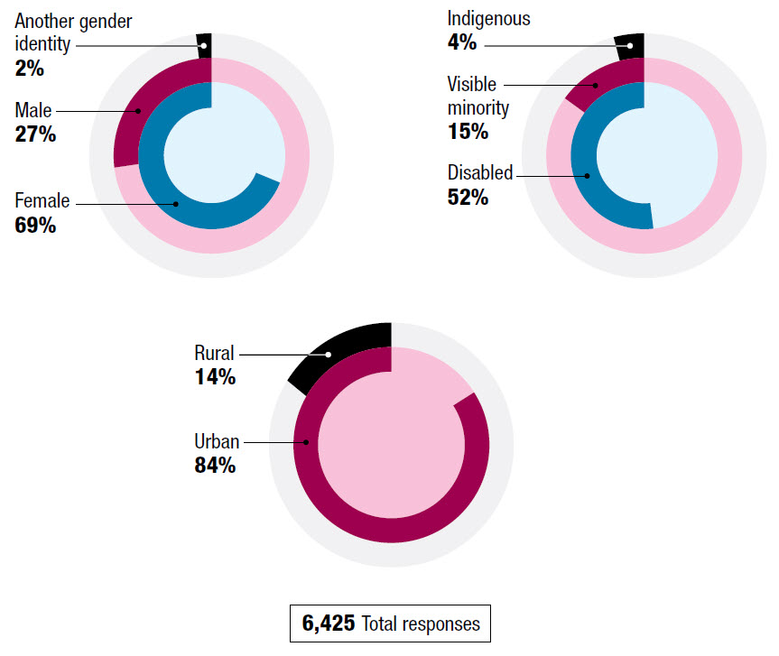
Breakdown of responses
Gender: Female (69%), male (27%), another gender identity (2%).
Rural (14%) / Urban (84%) /
Disabled (52%) / Visible Minority (15%), Indigenous (4%).
6425 People responded to the online consultation.

Slide 7
Was the process accessible?
"Normally, when I go to events, I need to worry about whether I can participate, enter the room, have space for my scooter or sit at the table. I have to call in advance and make back-up plans and my own arrangements. With these consultations, I didn't have to question or worry. They were accessible and I felt welcome.“
– Anonymous, Ottawa

Slide 8
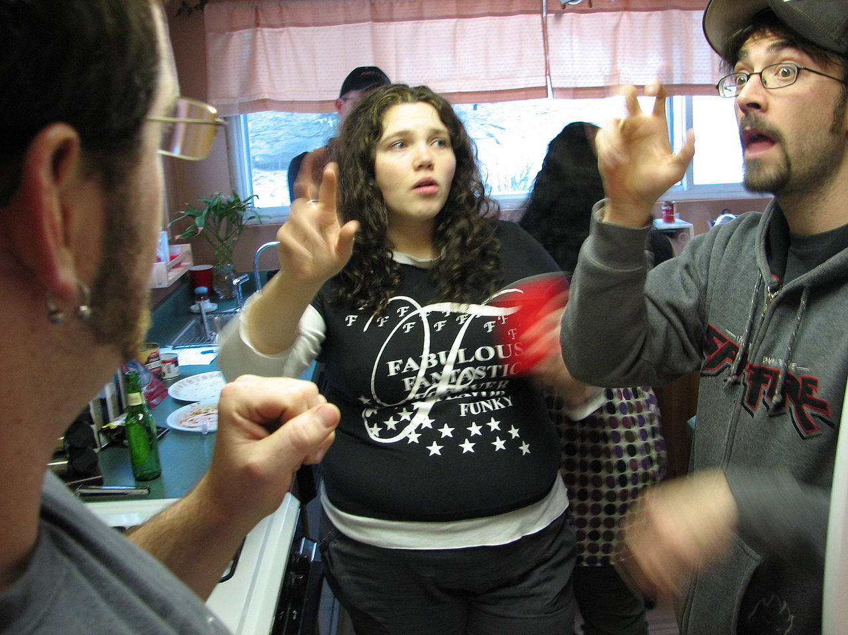
Sign language from Quebec
"This consultation was the first time in more than 20 years that I was able to use my language of choice, Langue des signes quebecoise, to communicate with my government.”
– Anonymous, Whitehorse

Slide 9
Nine month process. What was asked?
What should be the goal of the new legislation?
What accessibility barriers should be included?
How do we make sure the new legislation is being followed?
In addition to the new legislation, how should we better promote accessibility?
How do we ensure that all Canadians are informed on a regular basis if the new legislation is working, or if it needs to be improved?

Slide 10
Meaning of Disability
Participants indicated "disability" should include:
full range of abilities and limitations
including "invisible" disabilities (i.e., learning, mental health issues)
episodic disabilities (i.e. MS, Epilepsy)

Slide 11

An opinion of barrier
"My definition of 'barrier' is anything that impairs or prevents access, physically or mentally, to any physical movement, learning and/or acceptance by others. Ergo, 'accessibility' successfully counters or eliminates the barriers.“
– Pat Almond, Alberta

Slide 12
The Process of gathering information
Online consultation
Tour of Canada holding events
Procurement workshop
Expert opinion
Notes:
Shops online, banking, books a flight, hotel or getaway vacation, etc.
Uses wireless braille device

Slide 13
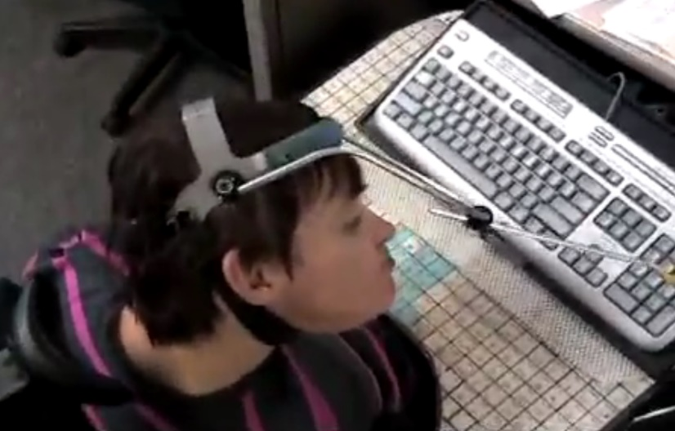
Key messages heard
Should be ambitious and bold
Should lead to more consistent experiences of accessibility across Canada (cooperation among GC, Provinces, Municipalities)
Should apply to stakeholders that are under Federal Law
Strongly enforced and contain penalties.
Opportunity to empower persons with disabilities with new leadership roles
Notes:
Teena is non-verbal, hand tremors make it difficult to use a keyboard and mouse but can use a head pointer & communication board

Slide 14
Key messages
"The federal government needs to put some 'teeth' into disability legislation, to police provincial and municipal compliance with regulations, and should also provide paid advocates to help the disabled ensure that their voices are heard.”
– Anonymous

Slide 15
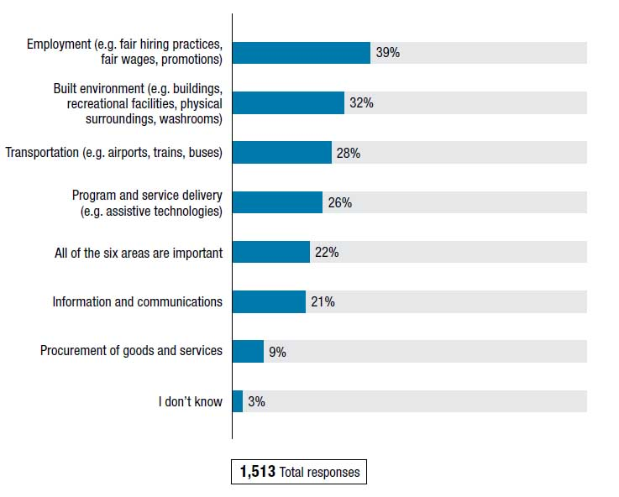
No clear priority consensus
Employment (39%),
Built environments (32%)
transportation (28%)
program and service delivery (26%)
All of the six areas are important (22%)
ITC (21%)
procurement (9%)
1,513 people responded to this question

Slide 16
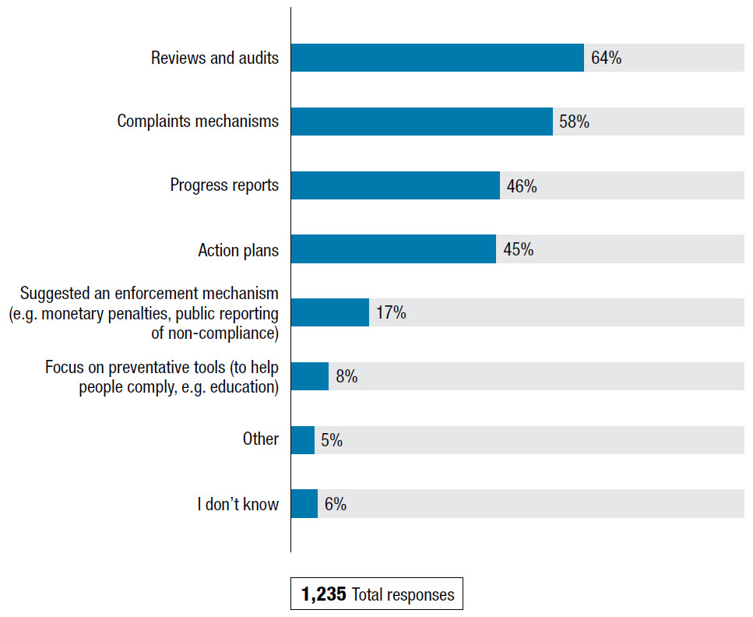
Monitoring
Audits (64%)
complaints mechanisms (58%),
progress reports (46%),
action plans (45%),
Penalties: i.e., fines, public reporting (17%),
focus on preventative tools (to help people comply, for example, education) (8%).
1,235 people responded to this question.

Slide 17
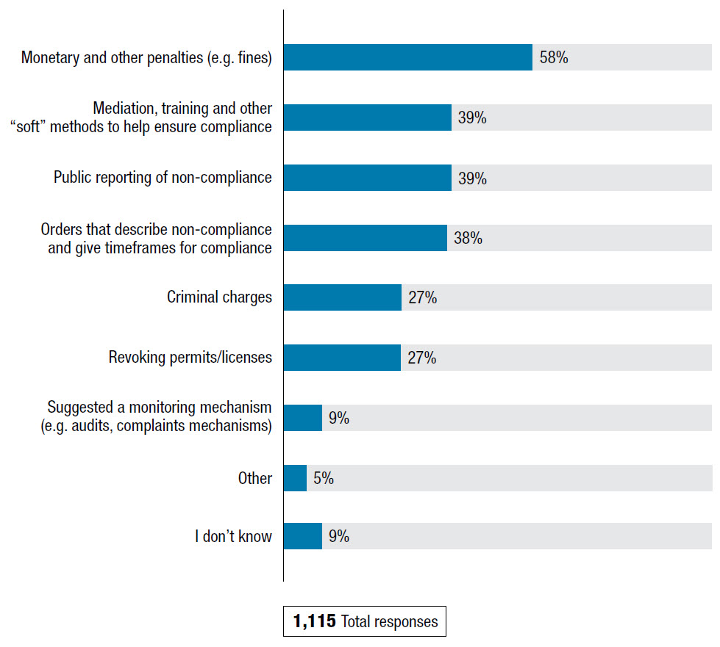
Reward good, penalize bad
Fines/other penalties (58%)
Mediation, training, "soft" methods, public reporting of non-compliance (39%)
orders that describe non-compliance w/ timeframes (38%),
Criminal charges (27%) a
Revoking permits/licences (27%).
1,115 people responded

Slide 18
What’s Next
Government has publicly said:
“we're going to take what we learned …to develop new federal accessibility legislation”
“… will also share what we learned with all levels of government and encourage them to join us”
“Together, we are making history”
https://www.canada.ca/en/employment-social-development/programs/planned-accessibility-legislation/reports/consultations-what-we-learned.html

Slide 19
Other Jurisdictions
Ontario (WCAG 2.0 for web sites)
US 508 (WCAG 2.0 for web, software, docs)
EN 301-549 (moving to 2.1 for web software, docs)
Australia (adopted 301-549)
Japan (JIS = ISO 40500:2012 = WCAG 2.0)
Norway (WCAG 2.0)
New Zealand (WCAG 2.0)
UK BS 8878

Slide 20
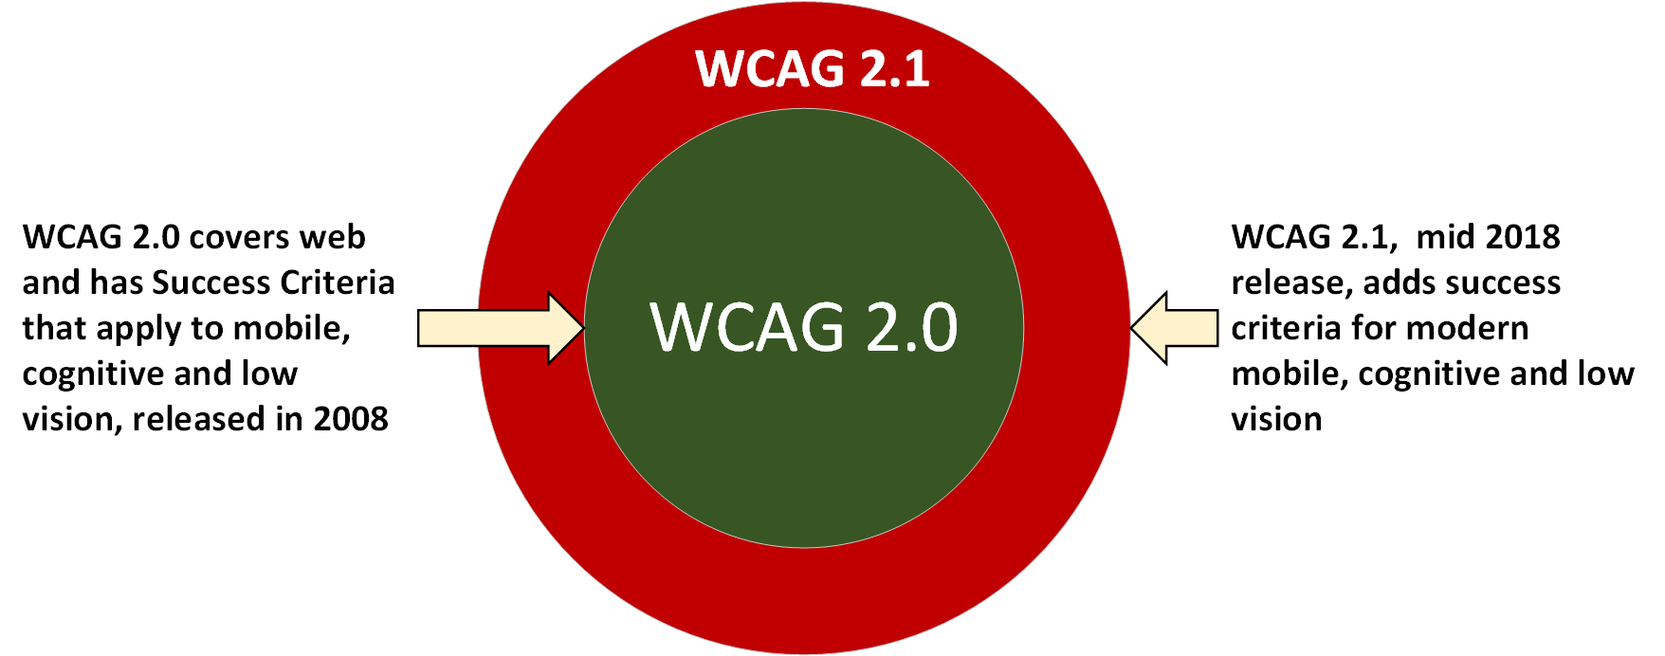
A bit about WCAG 2.1
Link to my blog article on WCAG 2.1 http://davidmacd.com/blog/wcag-2.1-quick-guide.html

Slide 21
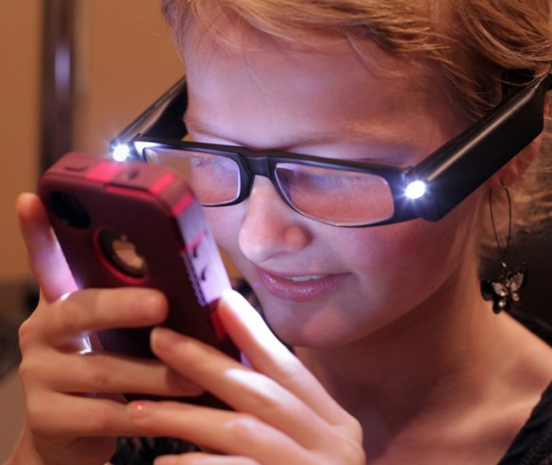
Questions about WCAG 2.0 and 2.1
Ask me anything about WCAG 2.0 or WCAG 2.1
Those questions that keep you up at night.

Slide 22
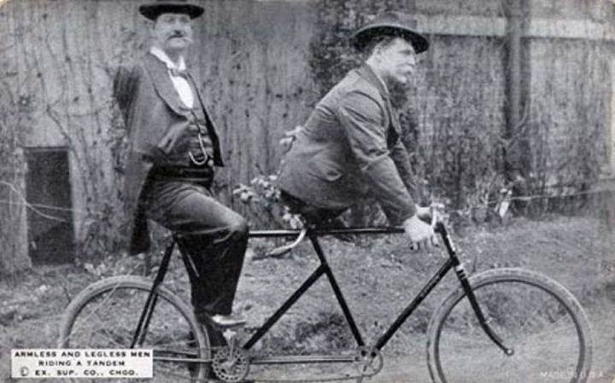
If we all cooperate we can solve accessibility together
Charles B. Tripp, the armless man and Eli Bowen, the legless man, riding a tandem. 1890s

Slide 23


David MacDonald
david@can-adapt.com
613-806-9005

